Slide 1
Global Economic Analysis on a Budget
Slides & More: www.kb.gg/georodeo
Kevin Booth

Slide 2
Who am I?
www.kb.gg/georodeo

Slide 3
Who am I?
www.kb.gg/georodeo
Graduate Student at Texas State University

Slide 4
Who am I?
www.kb.gg/georodeo
Graduate Student at Texas State University
Software Developer
NASA Johnson Space Center (Intern)
Swipejobs (Backend Developer)
Chaotic Moon Studios (Android Developer)

Slide 5
Who am I?
www.kb.gg/georodeo
Graduate Student at Texas State University
Software Developer
NASA Johnson Space Center (Intern)
Swipejobs (Backend Developer)
Chaotic Moon Studios (Android Developer)
Dog Dad

Slide 6
Today’s Topic
www.kb.gg/georodeo

Slide 7
Building a Satellite Imagery Processing Pipeline
www.kb.gg/georodeo

Slide 8
A History Lesson
www.kb.gg/georodeo
Notes:
Government Shutdown on December 22
35 Days Long
GDP Report delayed by a month
GDP gives us the pulse of the economy
Used by the federal reserve to determine monetary policy

Slide 9
GDP Reports are Important
www.kb.gg/georodeo
Measures the pulse of our economy

Slide 10
GDP Reports are Important
www.kb.gg/georodeo
Measures the pulse of our economy
Federal Reserve uses it to determine monetary policy
Investors use it to efficiently allocate resources

Slide 11
GDP Reports are Important
www.kb.gg/georodeo
Measures the pulse of our economy
Federal Reserve uses it to determine monetary policy
Investors use it to efficiently allocate resources
Valuing Ecosystem Services

Slide 12
Problems with GDP Reports
www.kb.gg/georodeo

Slide 13
Problems with GDP Reports
www.kb.gg/georodeo
Delayed by Government Shutdowns

Slide 14
Problems with GDP Reports
www.kb.gg/georodeo
Delayed by Government Shutdowns
Political Incentive to Under/Over Report

Slide 15
Problems with GDP Reports
www.kb.gg/georodeo
Delayed by Government Shutdowns
Political Incentive to Under/Over Report
Reported for Administrative Units

Slide 16
Thesis
www.kb.gg/georodeo

Slide 17
Thesis
www.kb.gg/georodeo
Estimating GDP using Satellite Imagery

Slide 18
Thesis
www.kb.gg/georodeo
Estimating GDP using Satellite Imagery
We previously used night-time imagery

Slide 19
Thesis
www.kb.gg/georodeo
Estimating GDP using Satellite Imagery
We previously used night-time imagery
Switching to SAR and Multispectral

Slide 20
Thesis
www.kb.gg/georodeo
Estimating GDP using Satellite Imagery
We previously used night-time imagery
Switching to SAR and Multispectral
Landsat Imagery

Slide 21
Thesis
www.kb.gg/georodeo
Estimating GDP using Satellite Imagery
We previously used night-time imagery
Switching to SAR and Multispectral
Landsat Imagery
Measuring effectiveness of a technique

Slide 22
Thesis
www.kb.gg/georodeo
Austin, TX

Slide 23
Thesis
www.kb.gg/georodeo
Austin, TX
Calculate Developed Area for 2002
Around 50 Landsat Scenes

Slide 24
Thesis
www.kb.gg/georodeo
Austin, TX
Calculate Developed Area for 2002
Around 50 Landsat Scenes
Repeat for every year until 2012

Slide 25
Thesis
www.kb.gg/georodeo
Austin, TX
Calculate Developed Area for 2002
Around 50 Landsat Scenes
Repeat for every year until 2012
Repeat for 199 more study areas
More than 100,000 scenes

Slide 26
Pipeline Steps
www.kb.gg/georodeo

Slide 27
Pipeline Steps
www.kb.gg/georodeo
Download Landsat Scenes

Slide 28
Pipeline Steps
www.kb.gg/georodeo
Download Landsat Scenes
Convert to ToA Reflectance

Slide 29
Pipeline Steps
www.kb.gg/georodeo
Download Landsat Scenes
Convert to ToA Reflectance
Calculate Developed Area Index

Slide 30
Pipeline Steps
www.kb.gg/georodeo
Download Landsat Scenes
Convert to ToA Reflectance
Calculate Developed Area Index
Calculate Cloud Mask

Slide 31
Pipeline Steps
www.kb.gg/georodeo
Download Landsat Scenes
Convert to ToA Reflectance
Calculate Developed Area Index
Calculate Cloud Mask
Create Cloud Free Composite

Slide 32
Pipeline Steps
www.kb.gg/georodeo
Download Landsat Scenes
Convert to ToA Reflectance
Calculate Developed Area Index
Calculate Cloud Mask
Create Cloud Free Composite
Calculate Total Developed Area

Slide 33
Software
www.kb.gg/georodeo

Slide 34
Software
www.kb.gg/georodeo
Python
rasterio
python-fmask

Slide 35
Software
www.kb.gg/georodeo
Python
rasterio
python-fmask
Kubernetes

Slide 36
Software
www.kb.gg/georodeo
Python
rasterio
python-fmask
Kubernetes
Airflow

Slide 37
Software
www.kb.gg/georodeo
Python
rasterio
python-fmask
Kubernetes
Airflow
PostgreSQL

Slide 38
Hardware
www.kb.gg/georodeo

Slide 39
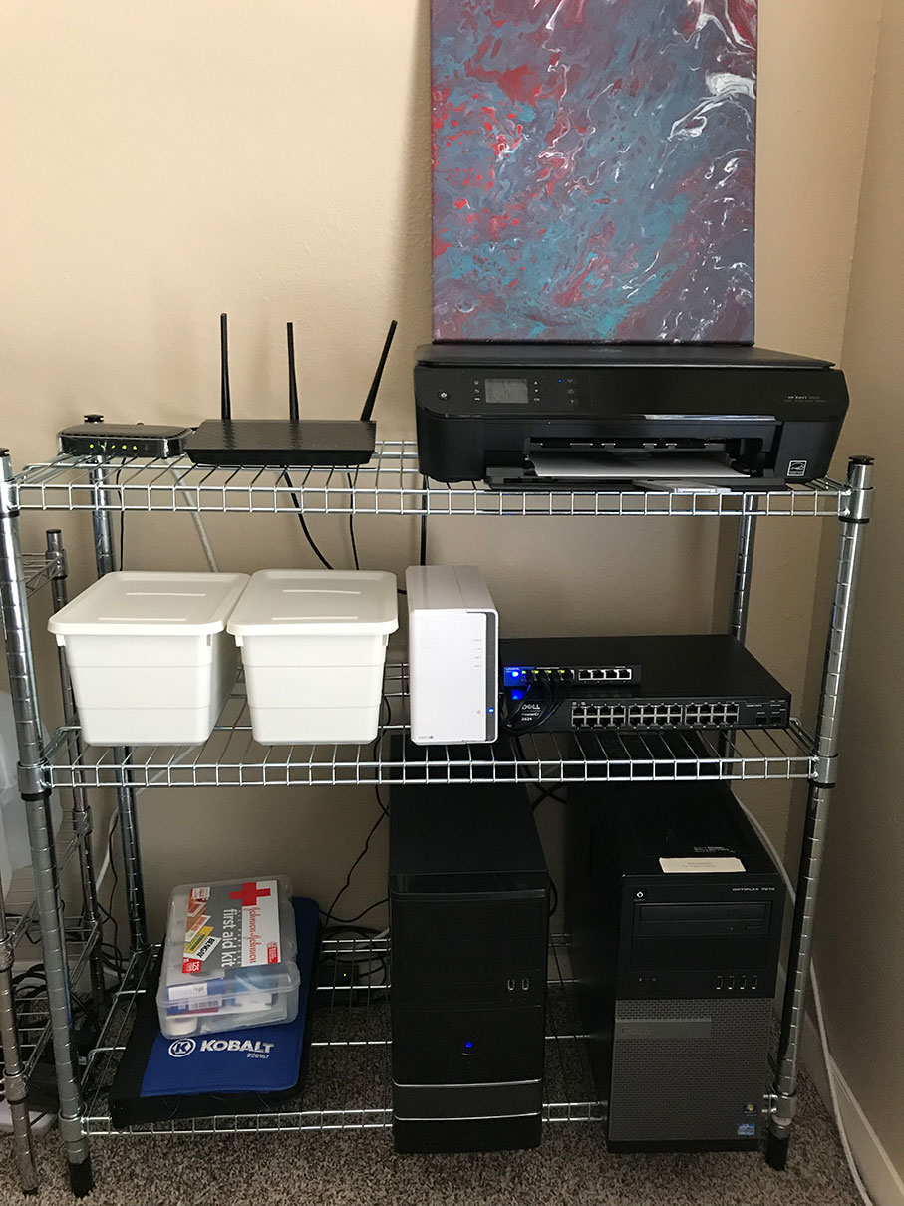
www.kb.gg/georodeo
Modem and Router

Slide 40
www.kb.gg/georodeo
Network Storage

Slide 41
www.kb.gg/georodeo
Gigabit Switch

Slide 42
www.kb.gg/georodeo
VirtualBox Host
K8s Master
Docker Registry
PostgreSQL

Slide 43
www.kb.gg/georodeo
K8s Node
Airflow
Processing Pods

Slide 44
Costs
www.kb.gg/georodeo
Modem and Router, Network Storage, and K8s Master
Already Had

Slide 45
Costs
www.kb.gg/georodeo
Modem and Router, Network Storage, and K8s Master
Already Had
Gigabit Switch
$35

Slide 46
Costs
www.kb.gg/georodeo
Modem and Router, Network Storage, and K8s Master
Already Had
Gigabit Switch
$35
K8s Node
$40
$45 – 16GB Memory
$30 – 240 GB SSD

Slide 47
Costs
www.kb.gg/georodeo
Modem and Router, Network Storage, and K8s Master
Already Had
Gigabit Switch
$35
K8s Node
$40
$45 – 16GB Memory
$30 – 240 GB SSD
Total: $150

Slide 48
www.kb.gg/georodeo

Slide 49
www.kb.gg/georodeo

Slide 50
Results
www.kb.gg/georodeo

Slide 51
Results
www.kb.gg/georodeo
1 Scene Processed in about 5.3 Minutes

Slide 52
Results
www.kb.gg/georodeo
1 Scene Processed in about 5.3 Minutes
4 scenes processed concurrently

Slide 53
Results
www.kb.gg/georodeo
1 Scene Processed in about 5.3 Minutes
4 scenes processed concurrently
1 scene every 1.325 minutes

Slide 54
Results
www.kb.gg/georodeo
1 Scene Processed in about 5.3 Minutes
4 scenes processed concurrently
1 scene every 1.325 minutes
1087 scenes per day

Slide 55
Results
www.kb.gg/georodeo
1 Scene Processed in about 5.3 Minutes
4 scenes processed concurrently
1 scene every 1.325 minutes
1087 scenes per day
Landsat Program Scenes Captured per Day?

Slide 56
Results
www.kb.gg/georodeo
1 Scene Processed in about 5.3 Minutes
4 scenes processed concurrently
1 scene every 1.325 minutes
1087 scenes per day
Landsat Program Scenes Captured per Day?
Around 1000

Slide 57
Unexpected Issues
www.kb.gg/georodeo

Slide 58
Unexpected Issues
www.kb.gg/georodeo
Managed Switch

Slide 59
Unexpected Issues
www.kb.gg/georodeo
Managed Switch
Loud

Slide 60
Unexpected Issues
www.kb.gg/georodeo
Managed Switch
Loud
Power hungry

Slide 61
Unexpected Issues
www.kb.gg/georodeo
Managed Switch
Loud
Power hungry
DIY Pipeline Orchestration with Message Queuing

Slide 62
Unexpected Issues
www.kb.gg/georodeo
Managed Switch
Loud
Power hungry
DIY Pipeline Orchestration with Message Queuing
Difficult to debug

Slide 63
Unexpected Issues
www.kb.gg/georodeo
Managed Switch
Loud
Power hungry
DIY Pipeline Orchestration with Message Queuing
Difficult to debug
More code written for orchestrating than processing

Slide 64
Shameless Self-Promotion
www.kb.gg/georodeo

Slide 65
Q&A
www.kb.gg/georodeo

